Slide 1
Biomimicry

Slide 2
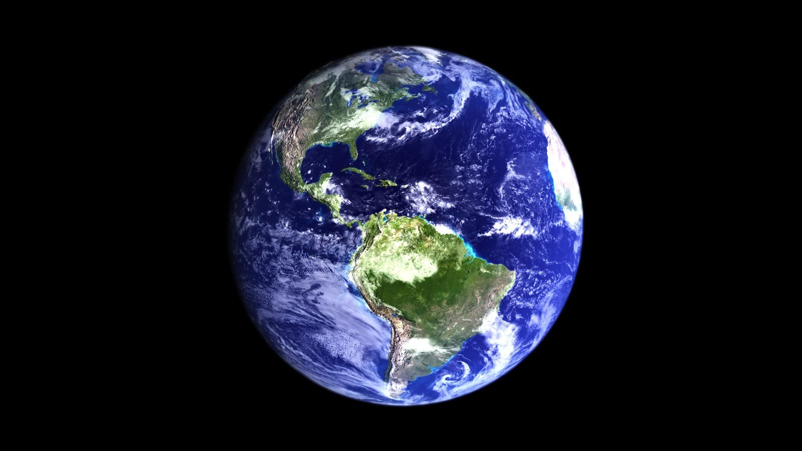
“Nature is our biggest ally, and our greatest inspiration. We just have to do what nature has always done. It worked out the secret of life long ago.”
-David Attenborough

Slide 3
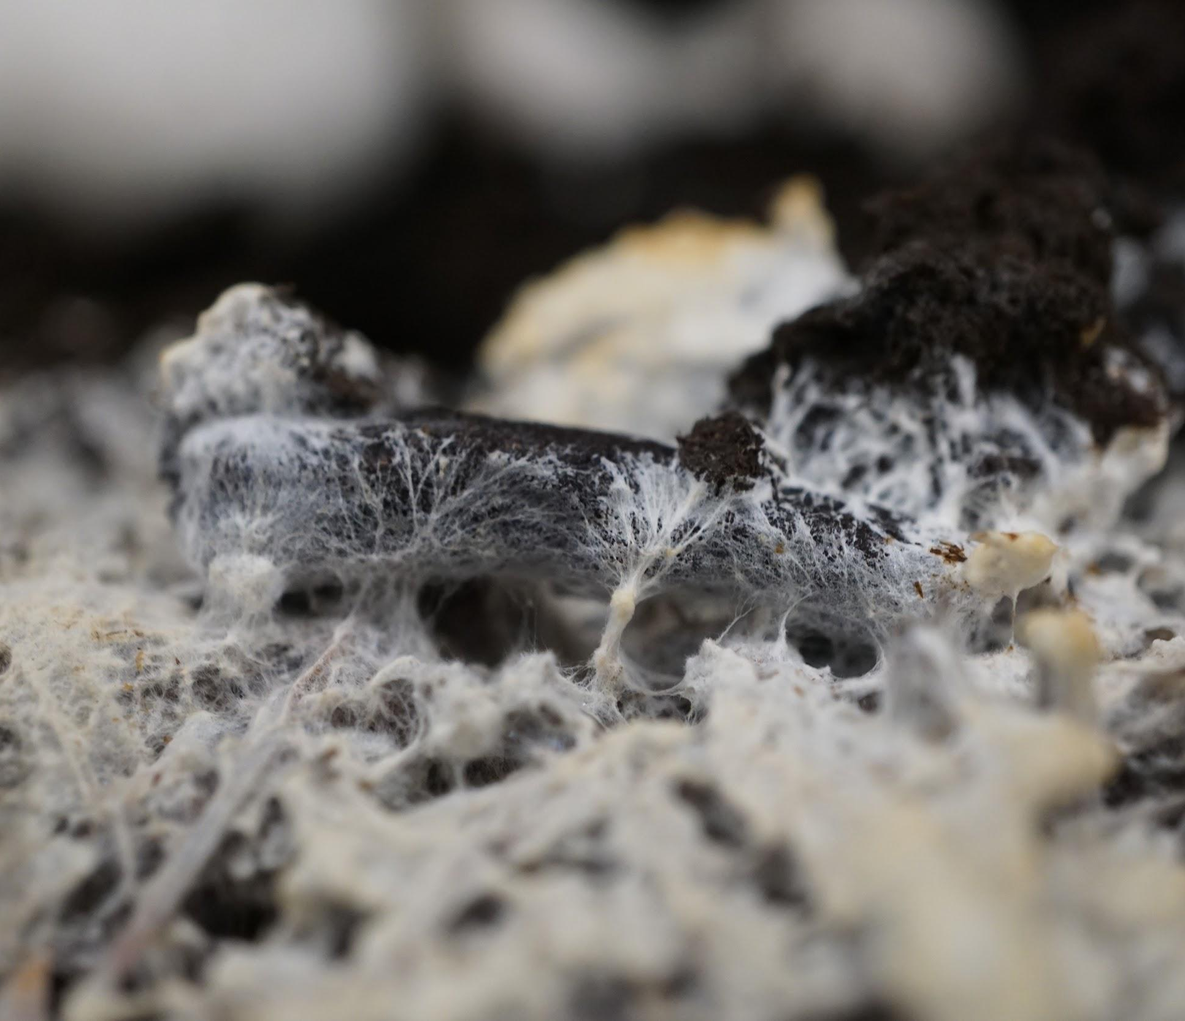
What is biomimicry?
Biomimicry is the practice of applying lessons from nature to the invention of healthier, more sustainable technologies for people.

Slide 4
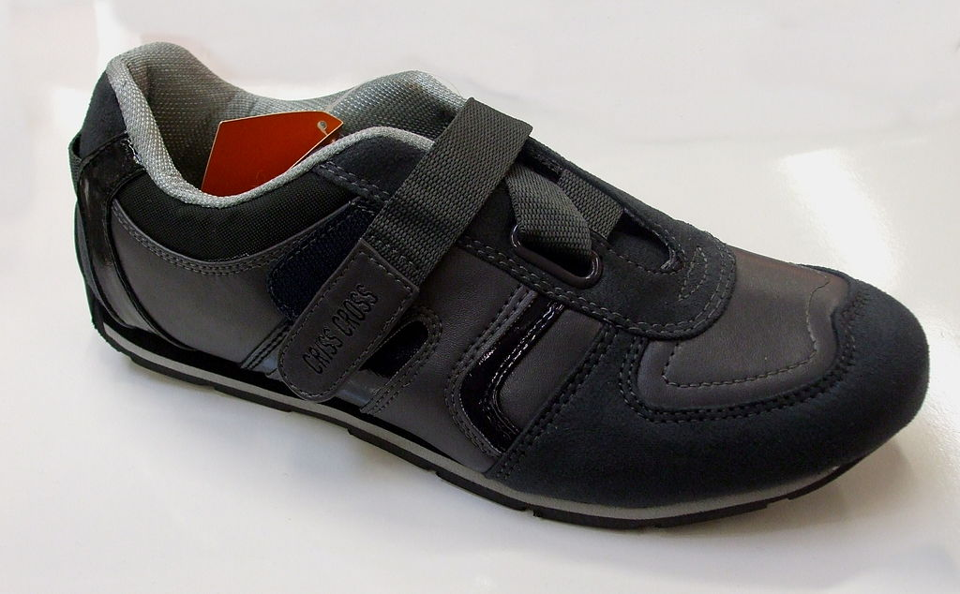
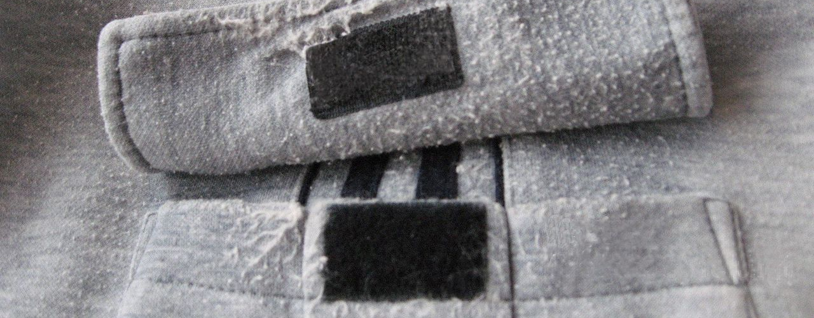
Challenge: look around your house for something that uses Velcro.
Inspired by nature!?
Congratulations, you have found a bio-inspired design!

Slide 5
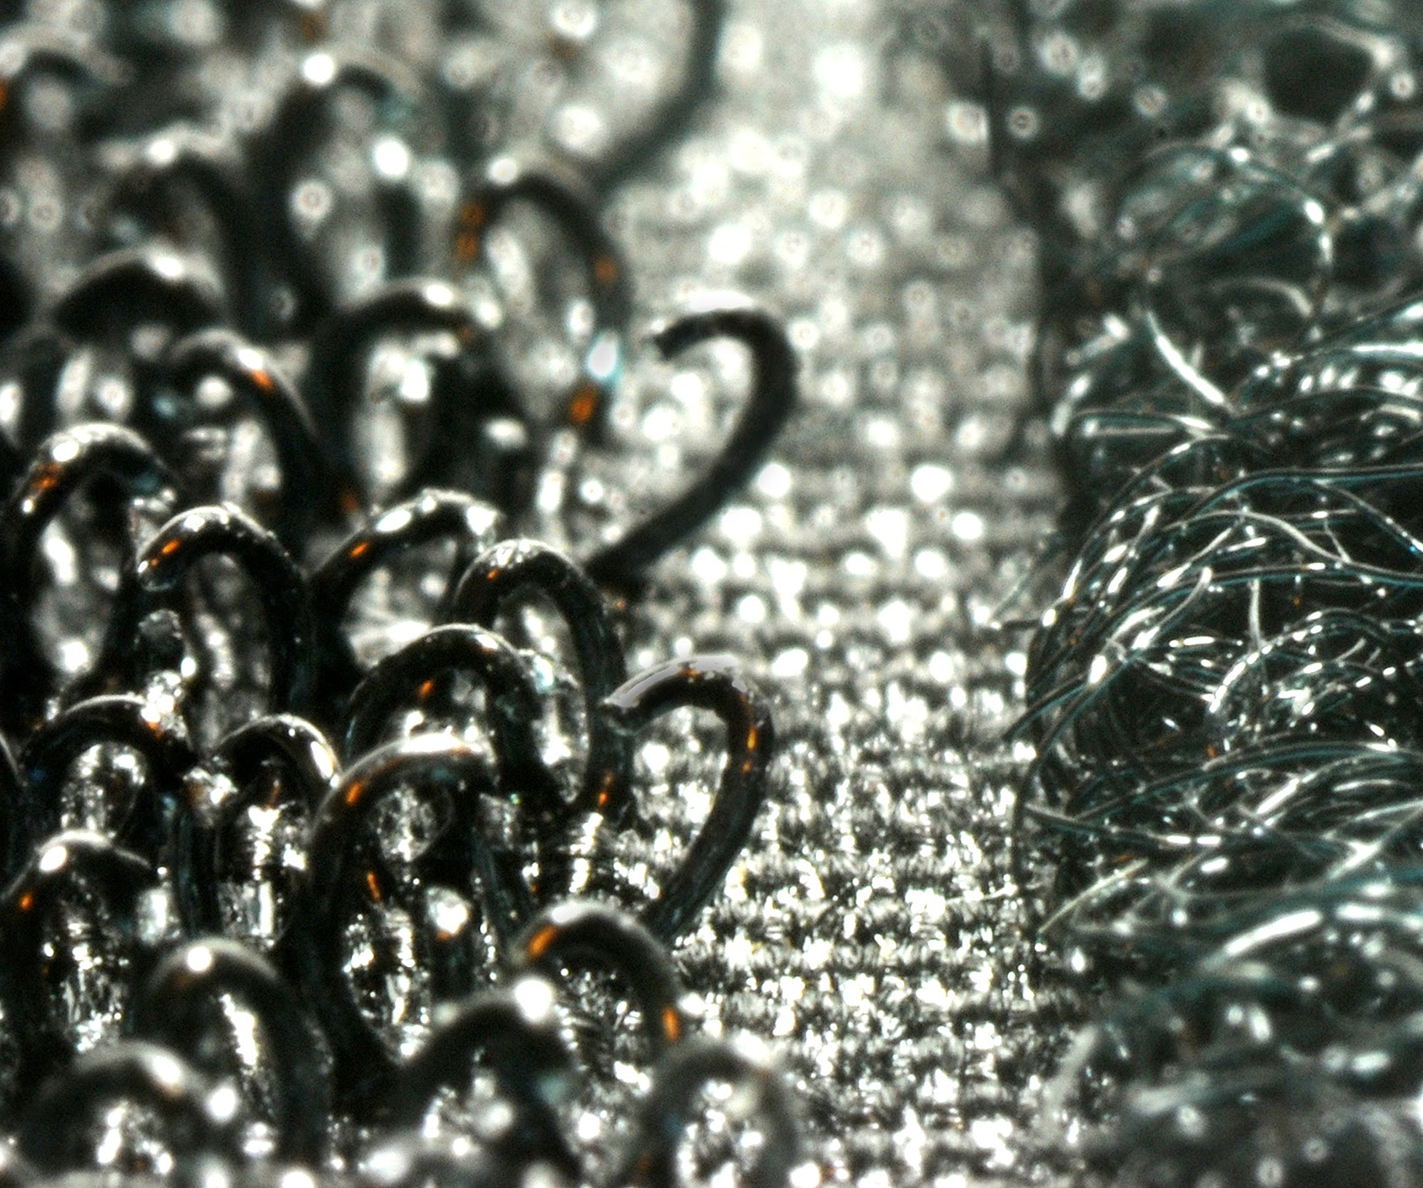
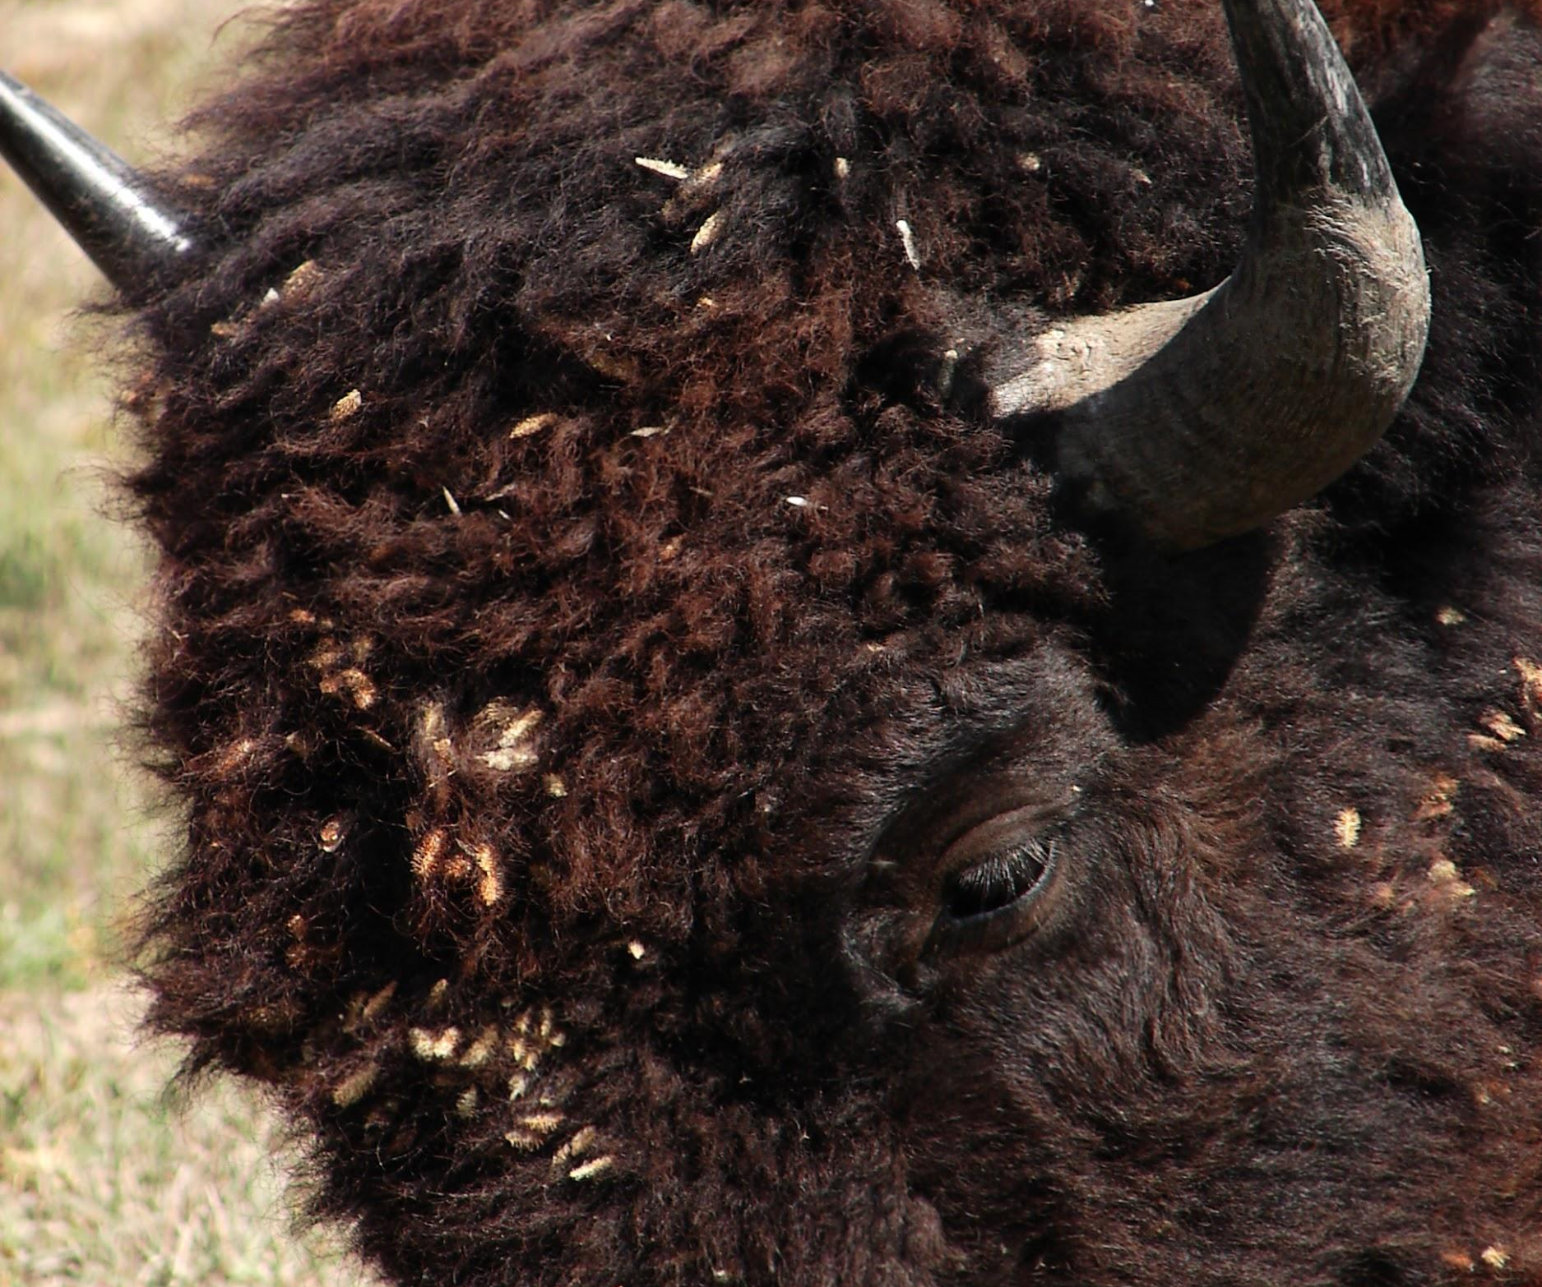
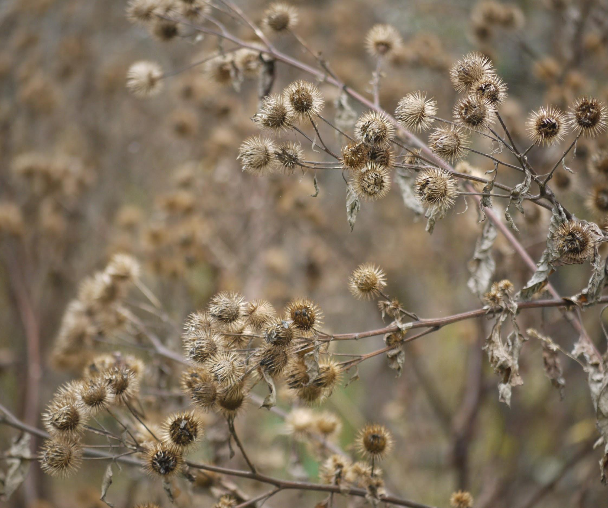
Velcro inspiration: burrs
Tiny hooks on seeds grab on to animal fur quite nicely!

Slide 6
Let’s look at some more examples.

Slide 7
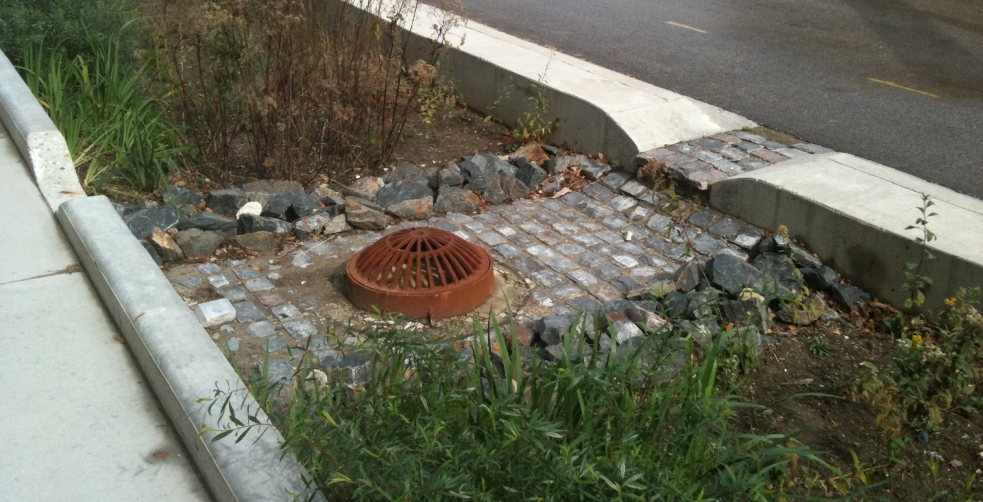
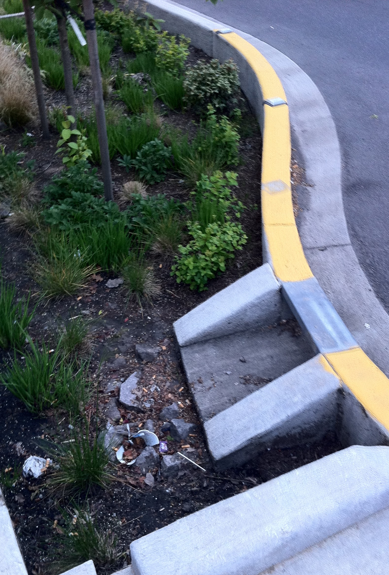
Urban water filter design (bioswale)
Portland, Oregon
Milwaukee, Wisconsin
Plants, rocks, and soil slow the flow of water from city streets and filter pollutants before they reach waterways (rivers, streams, etc).

Slide 8
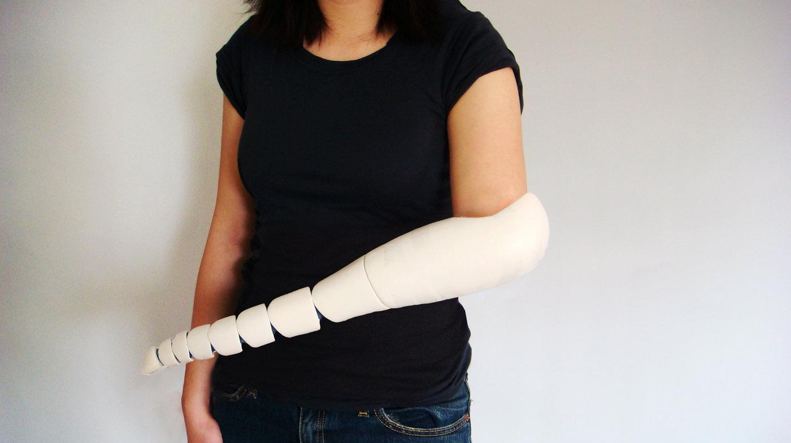
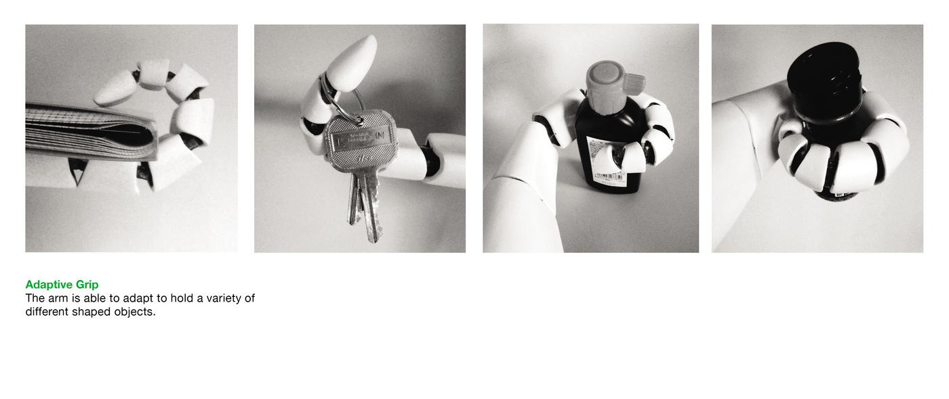
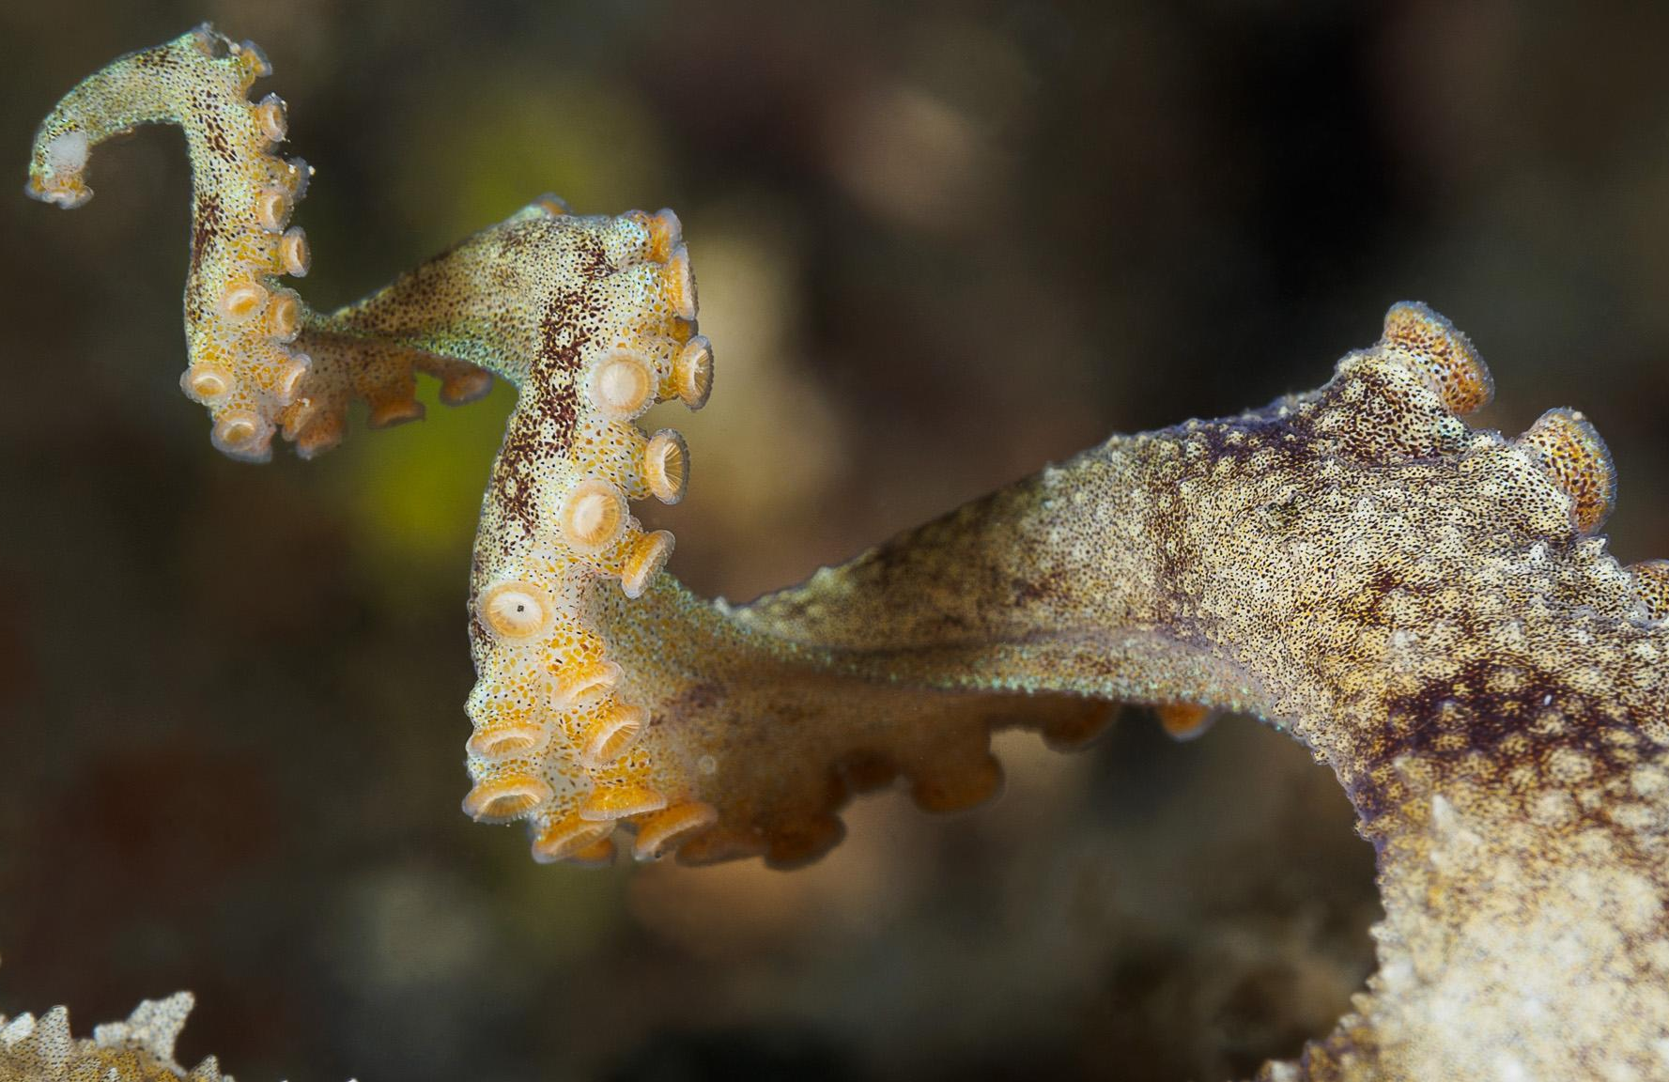
Prosthetic “octopus” arm design
“Through extensive research I found that the prosthetic functioned as an assistant to the dominant functioning hand. The prosthetic needed to be both flexible and adjustable in order to accommodate a variety of different grips.”
-Kaylene Kau, inventor
Notes:
https://www.coroflot.com/kaylenek/PROSTHETIC-ARM

Slide 9
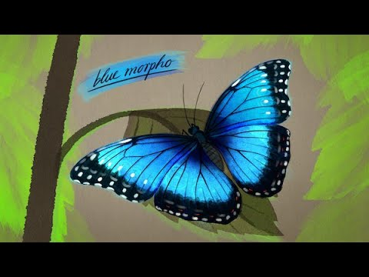
Butterfly wing structural color design
Inspired by the wings of the blue morpho butterfly, this coating can be applied as an environmentally friendly (non-toxic) alternative to paint!
Notes:
Cypris Materials has developed a tunable structural color coating that can be applied directly to surfaces as a paint. Their technology can improve building and automobile energy efficiency by reflecting UV, visible, and infrared light, and it expands the available color pallet while eliminating the use of toxic pigments and colorants.
To learn more about Cypris Materials and their nature-inspired innovation, visit:
http://www.asknature.org/strategy/win...
http://www.biomimicry.org/solution/cy...
http://www.cyprismaterials.com
Art and Animation by Jules Bartl
Produced and Narrated by Ed Prosser
With special thanks to support from the Ray C. Anderson Foundation.

Slide 10
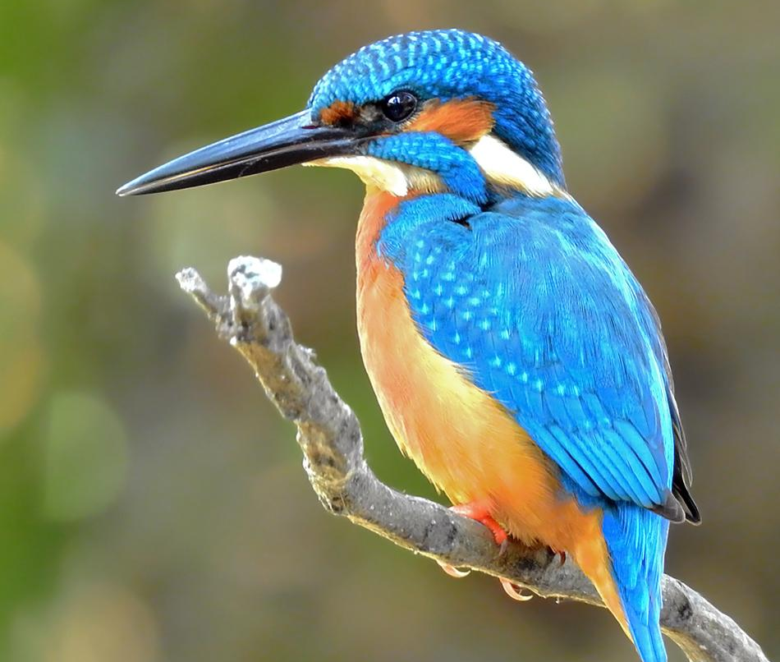
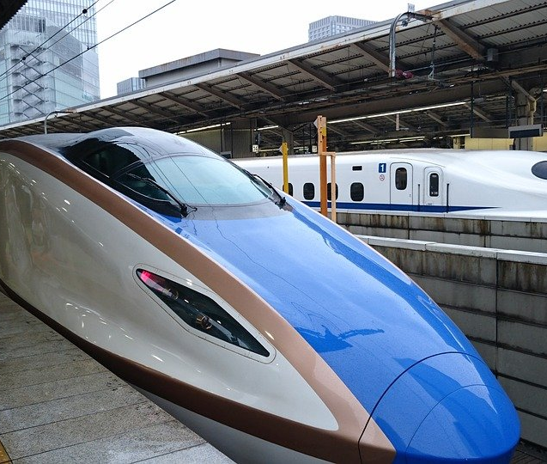
Japanese bullet train inspired by kingfisher beak to be quieter, more aerodynamic
Notes:
https://asknature.org/idea/shinkansen-train/

Slide 11
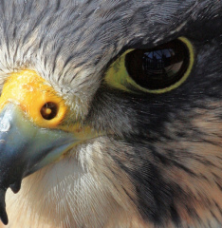
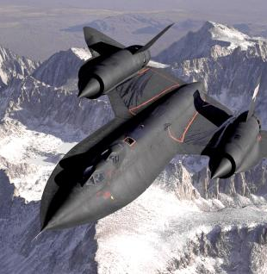
Jet engine uses cone shape found in peregrine falcon nostril to move air through at high speeds
Notes:
Images found here https://zackandscottkarmachameleons.wordpress.com/2016/04/08/jet-engine-evolution-inspired-by-the-peregrine-falcon/

Slide 12
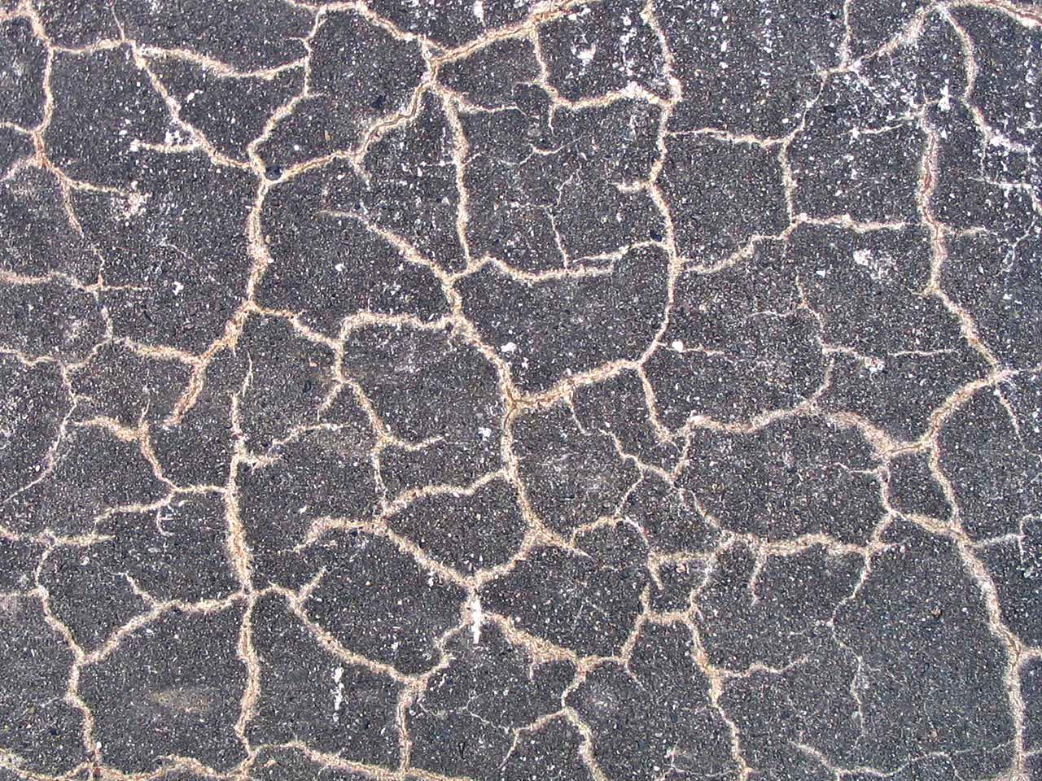
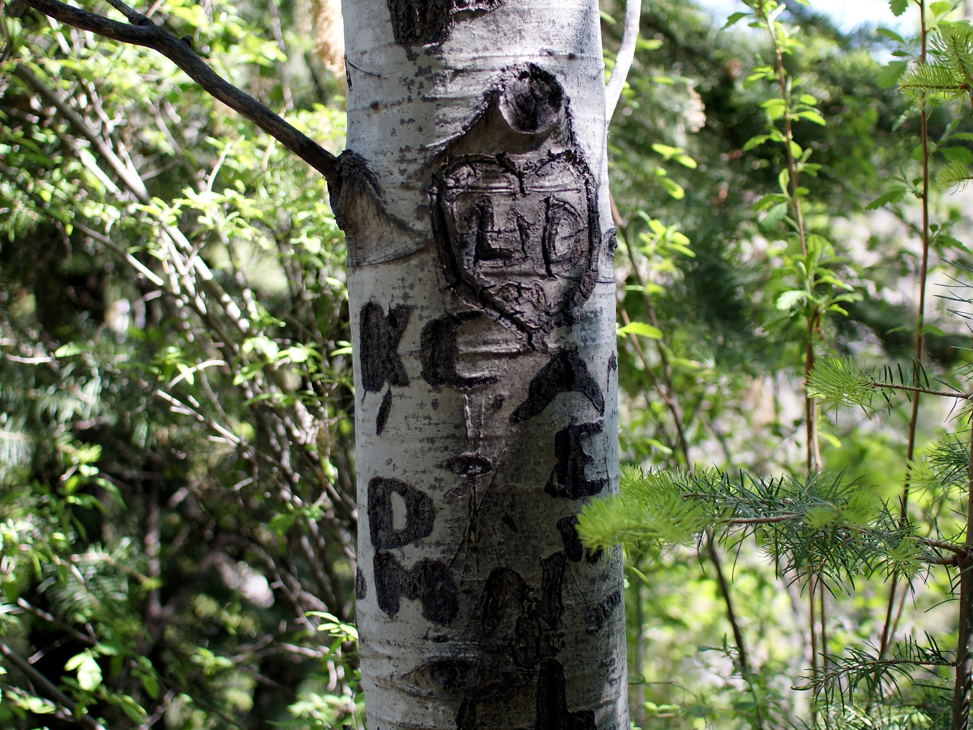
Self-repairing concrete uses the concept of self-healing found in nature, from trees to our own skin
Notes:
https://asknature.org/idea/self-repairing-concrete-2/

Slide 13
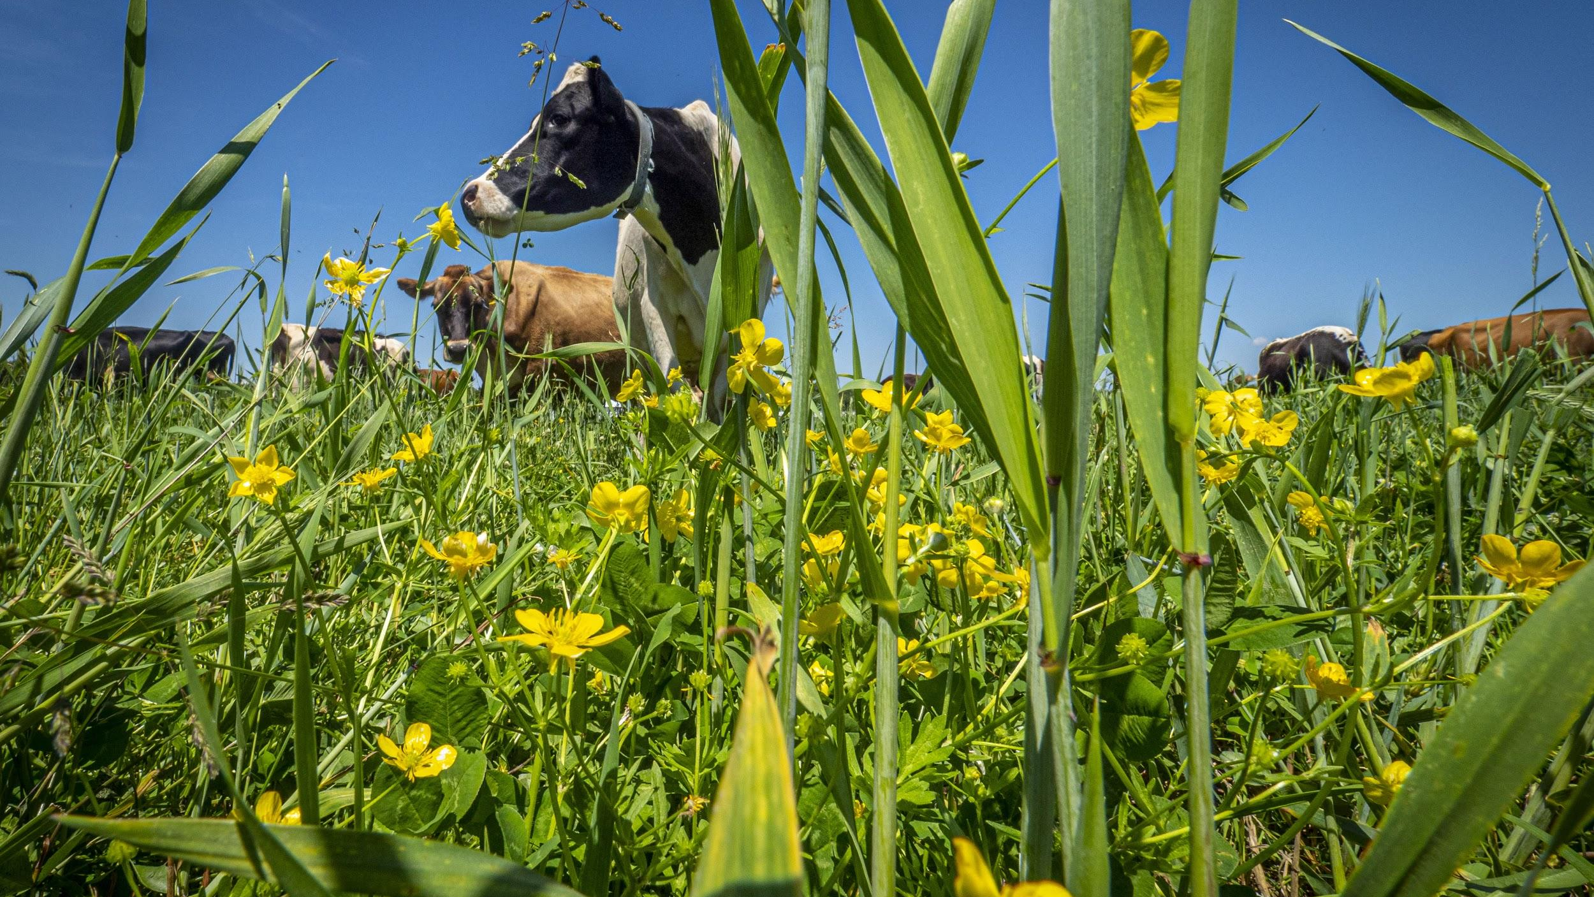
Regenerative agriculture uses grazing animals, native plants, and less water to build healthy soil through a more natural, balanced system

Slide 14
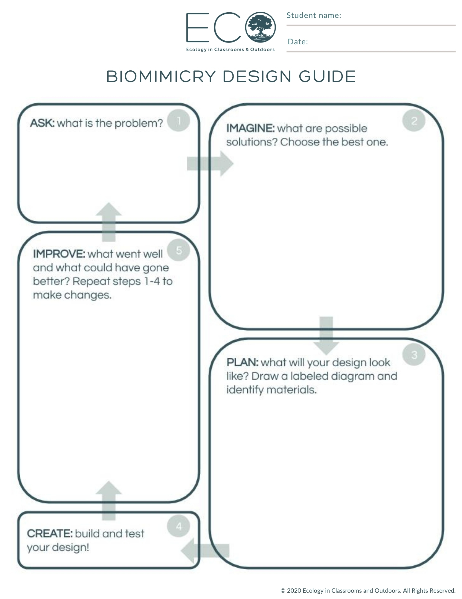
Activity: design your own!
Helpful questions to get you started:
What problem are you trying to solve?
How does nature solve the problem?
Is there an animal or group of animals you are inspired by?
Is there an ecosystem that you find interesting? How does it thrive?
What materials are needed for this product or idea?

Slide 15
More helpful questions
SYSTEM/STRATEGY: what systems are in place that help the organism survive?
What strategies or relationships does the group of organisms use to survive?
FORM: how is it shaped or built, and how does the shape help it do its job?
EFFICIENCY: how does it use the least amount of resources or energy for the maximum benefit?
How does it function with zero to little waste?
RESILIENCE: what does it use to ensure it can withstand the test of time?
How does it “bounce back” after a disturbance?

Slide 16
Want to learn more about biomimicry?
Check out these resources:
Ask Nature - www.asknature.org
The Biomimicry Institute - https://biomimicry.org/

Slide 17
Want to join the Biomimicry Institute
Youth Design Challenge?
Click here for more information

