Slide 1
Cold Weather Animals Pt. I
Ectotherms

Slide 2
What is an ectotherm?
A “cold-blooded” animal, or...
An animal that relies on external sources of heat and behavioral adaptations to maintain body temperature.
Reptiles, amphibians, fish, invertebrates (insects, arachnids, mollusks, crustaceans)

Slide 3
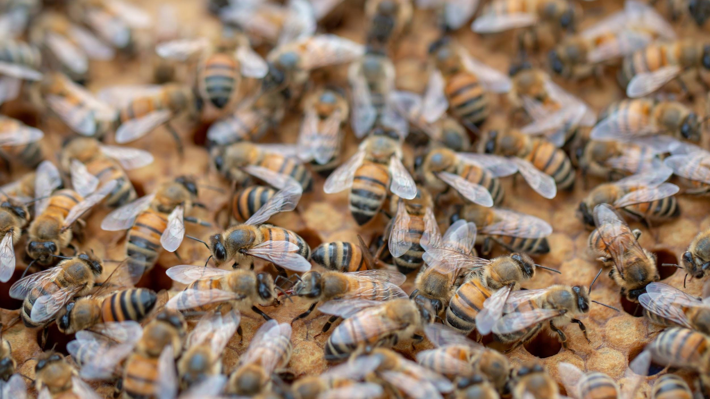
Huddling
honey bees
Behavioral adaptations:
Bees in the colony are replaced by “winter bees” which are larger and live longer
Bees cache (store) extra food so they have enough energy to last the winter
Bees “cuddle” together in a cluster and buzz, creating warmth for the queen
Notes:
https://www.youtube.com/watch?v=aPj0W2eT9PM <- watch this great video for more information!

Slide 4
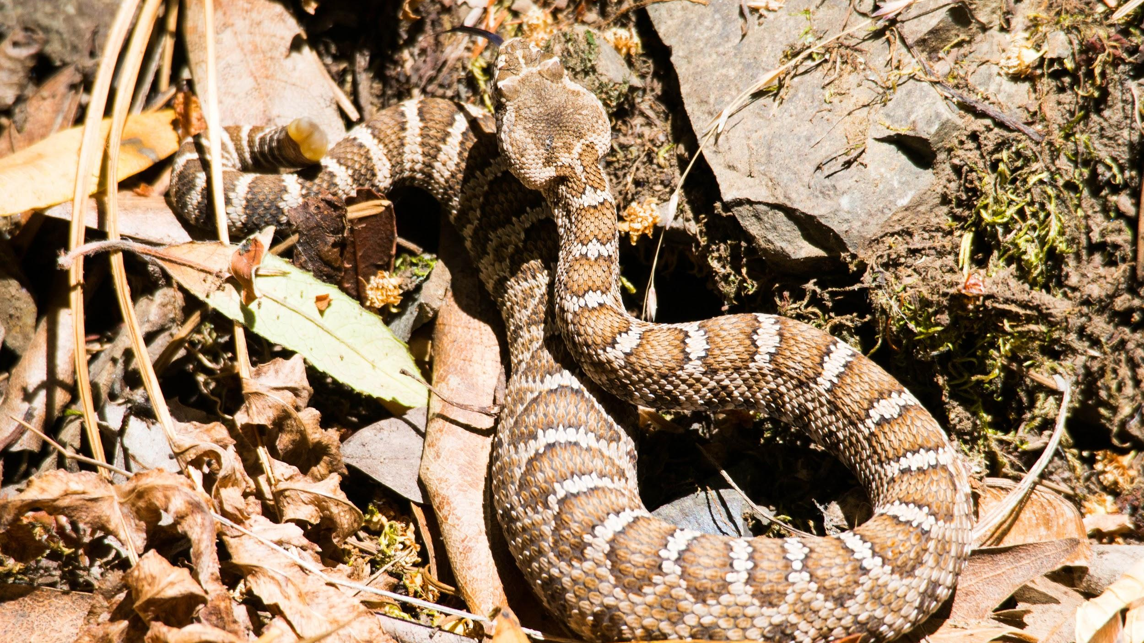
Sun-seeking
snakes
Behavioral adaptations:
Bask in the sun to soak up thermal energy
Cuddle together for warmth, in dens or under rocks
Dormancy: slowing down the body to use less energy

Slide 5
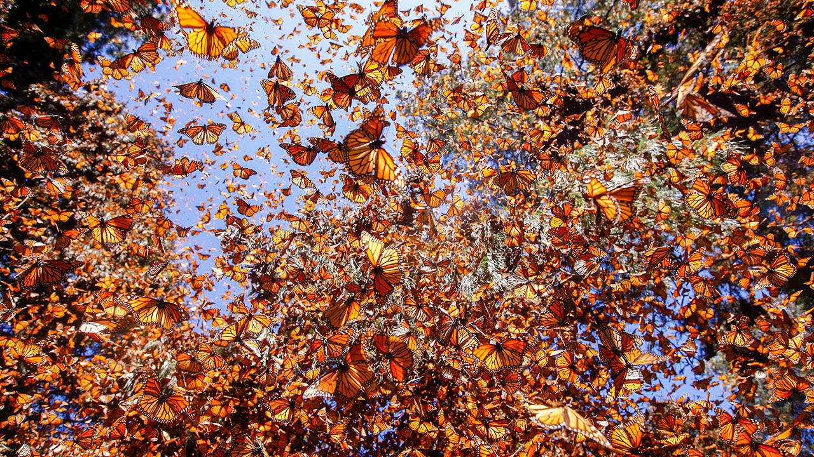
Migrating monarchs
Behavioral adaptations:
Monarch butterflies migrate to warmer climates during the North American winter
Other moth & butterfly larvae form a cocoon or chrysalis during the winter months

Slide 6
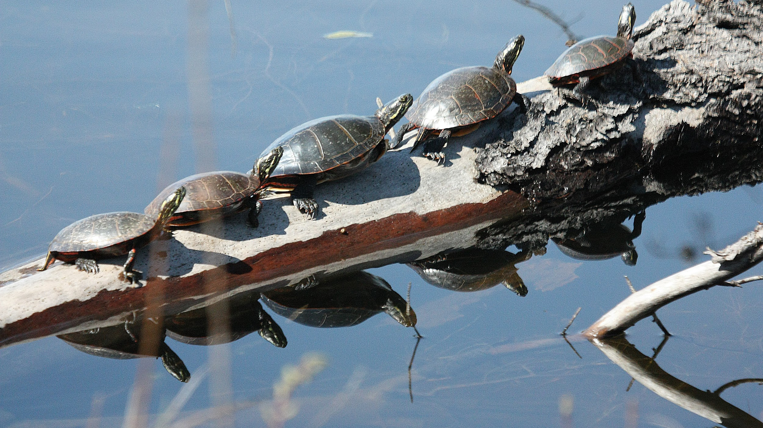
Tough turtles
Behavioral adaptations:
Lay dormant in groups through the winter at the bottom of ponds (water insulates better than air)
Bask in the sun on rocks or logs to soak up thermal energy
Physiological adaptations:
Change their metabolism to require less oxygen

Slide 7
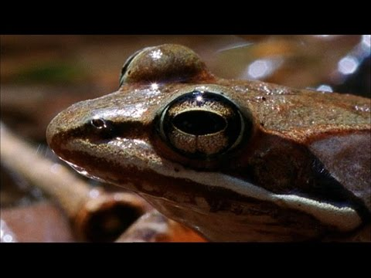
Frozen frogs
Behavioral adaptation:
Most frogs go through dormancy
Physiological adaptation:
Some frogs’ bodies produce a “natural antifreeze” that keeps it alive while frozen throughout the winter (see video)

Slide 8
Do you want to help ectotherms in your own
community this winter?

Slide 9
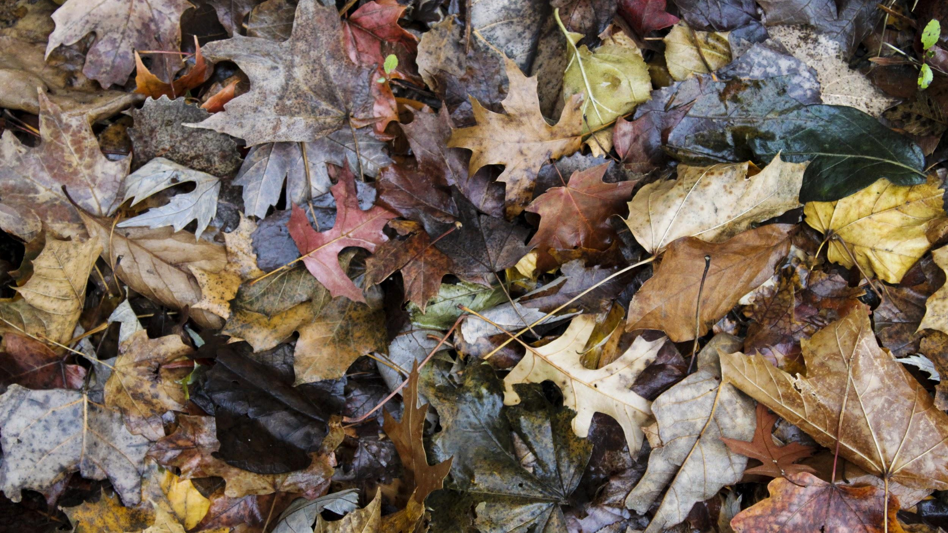
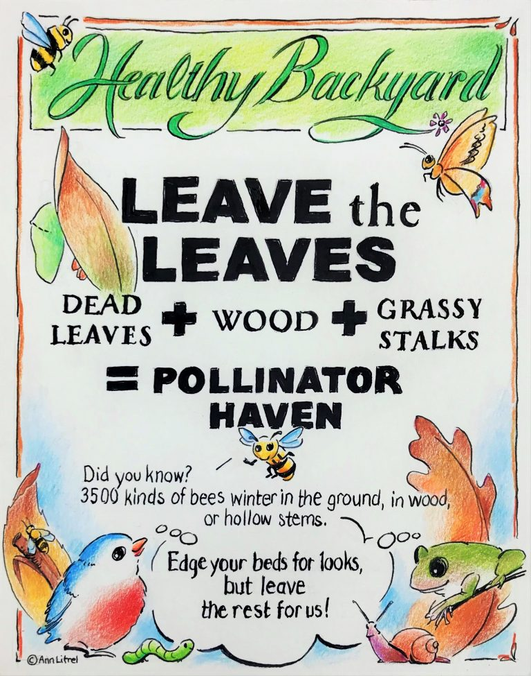
Leave fallen leaves on the ground
Bugs, slugs, frogs, salamanders, snakes, and other animals burrow under leaf litter for protection from the cold.

Slide 10
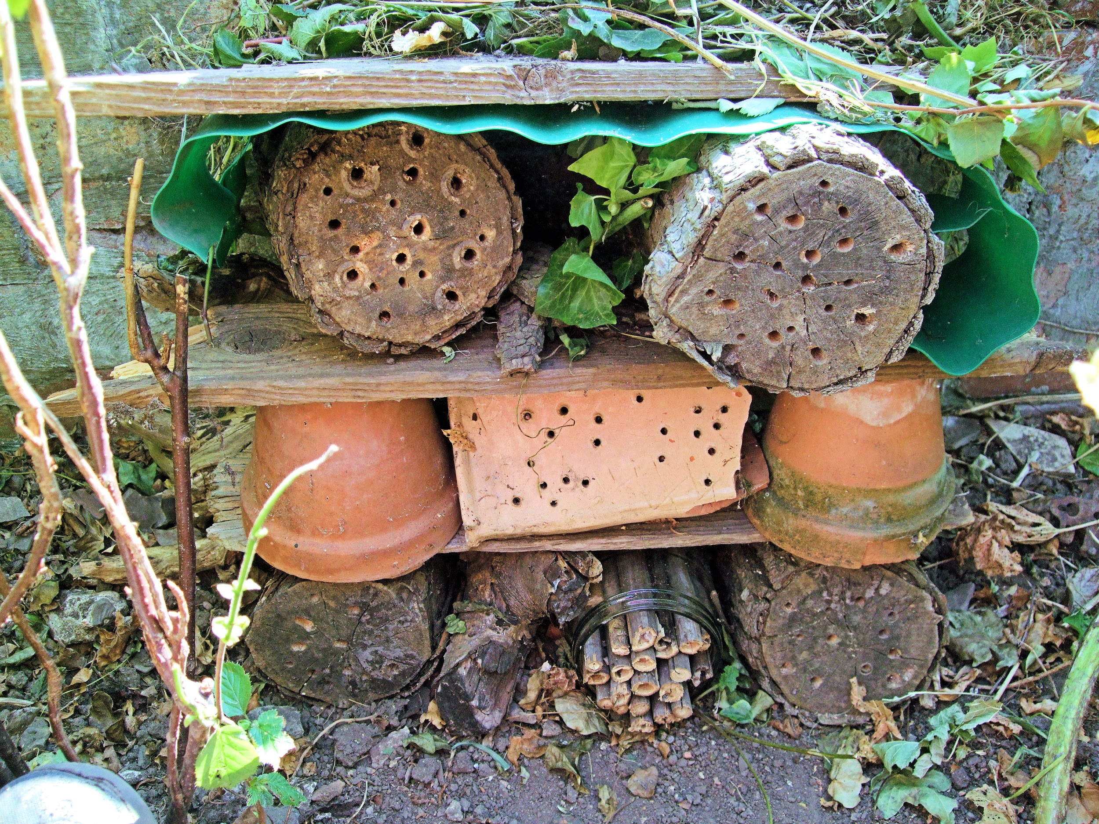
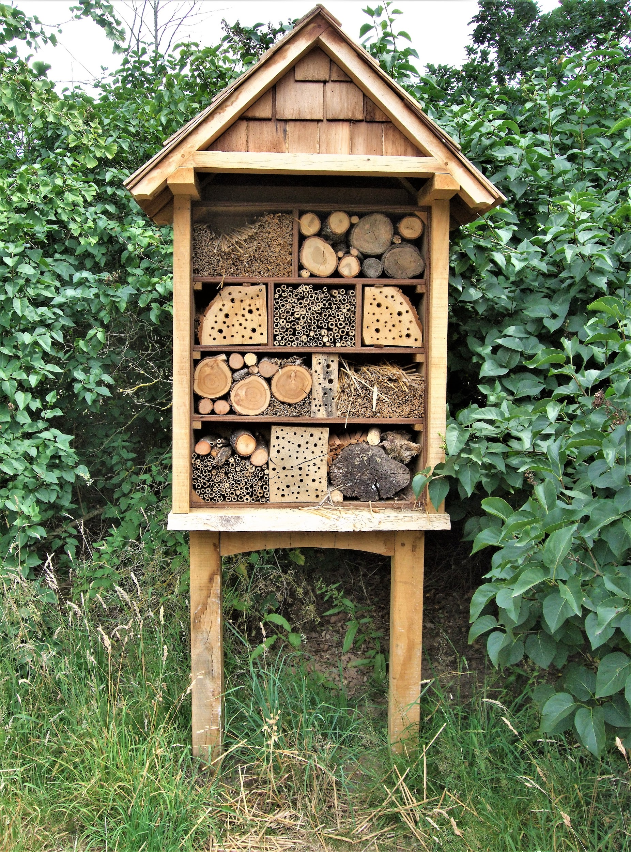
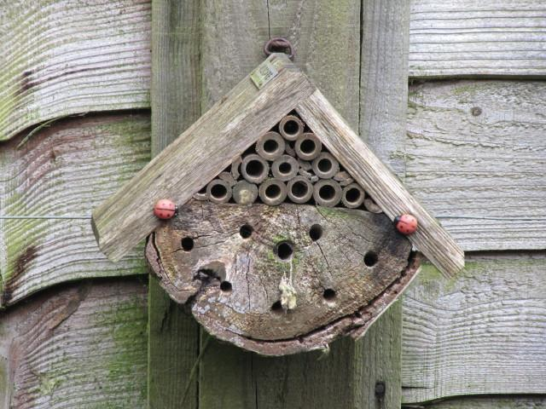
2. Create a bug “hotel”
Many bugs seek safe, cozy holes to lay their eggs in, incubate larvae, or protect themselves from the cold of winter.

Slide 11
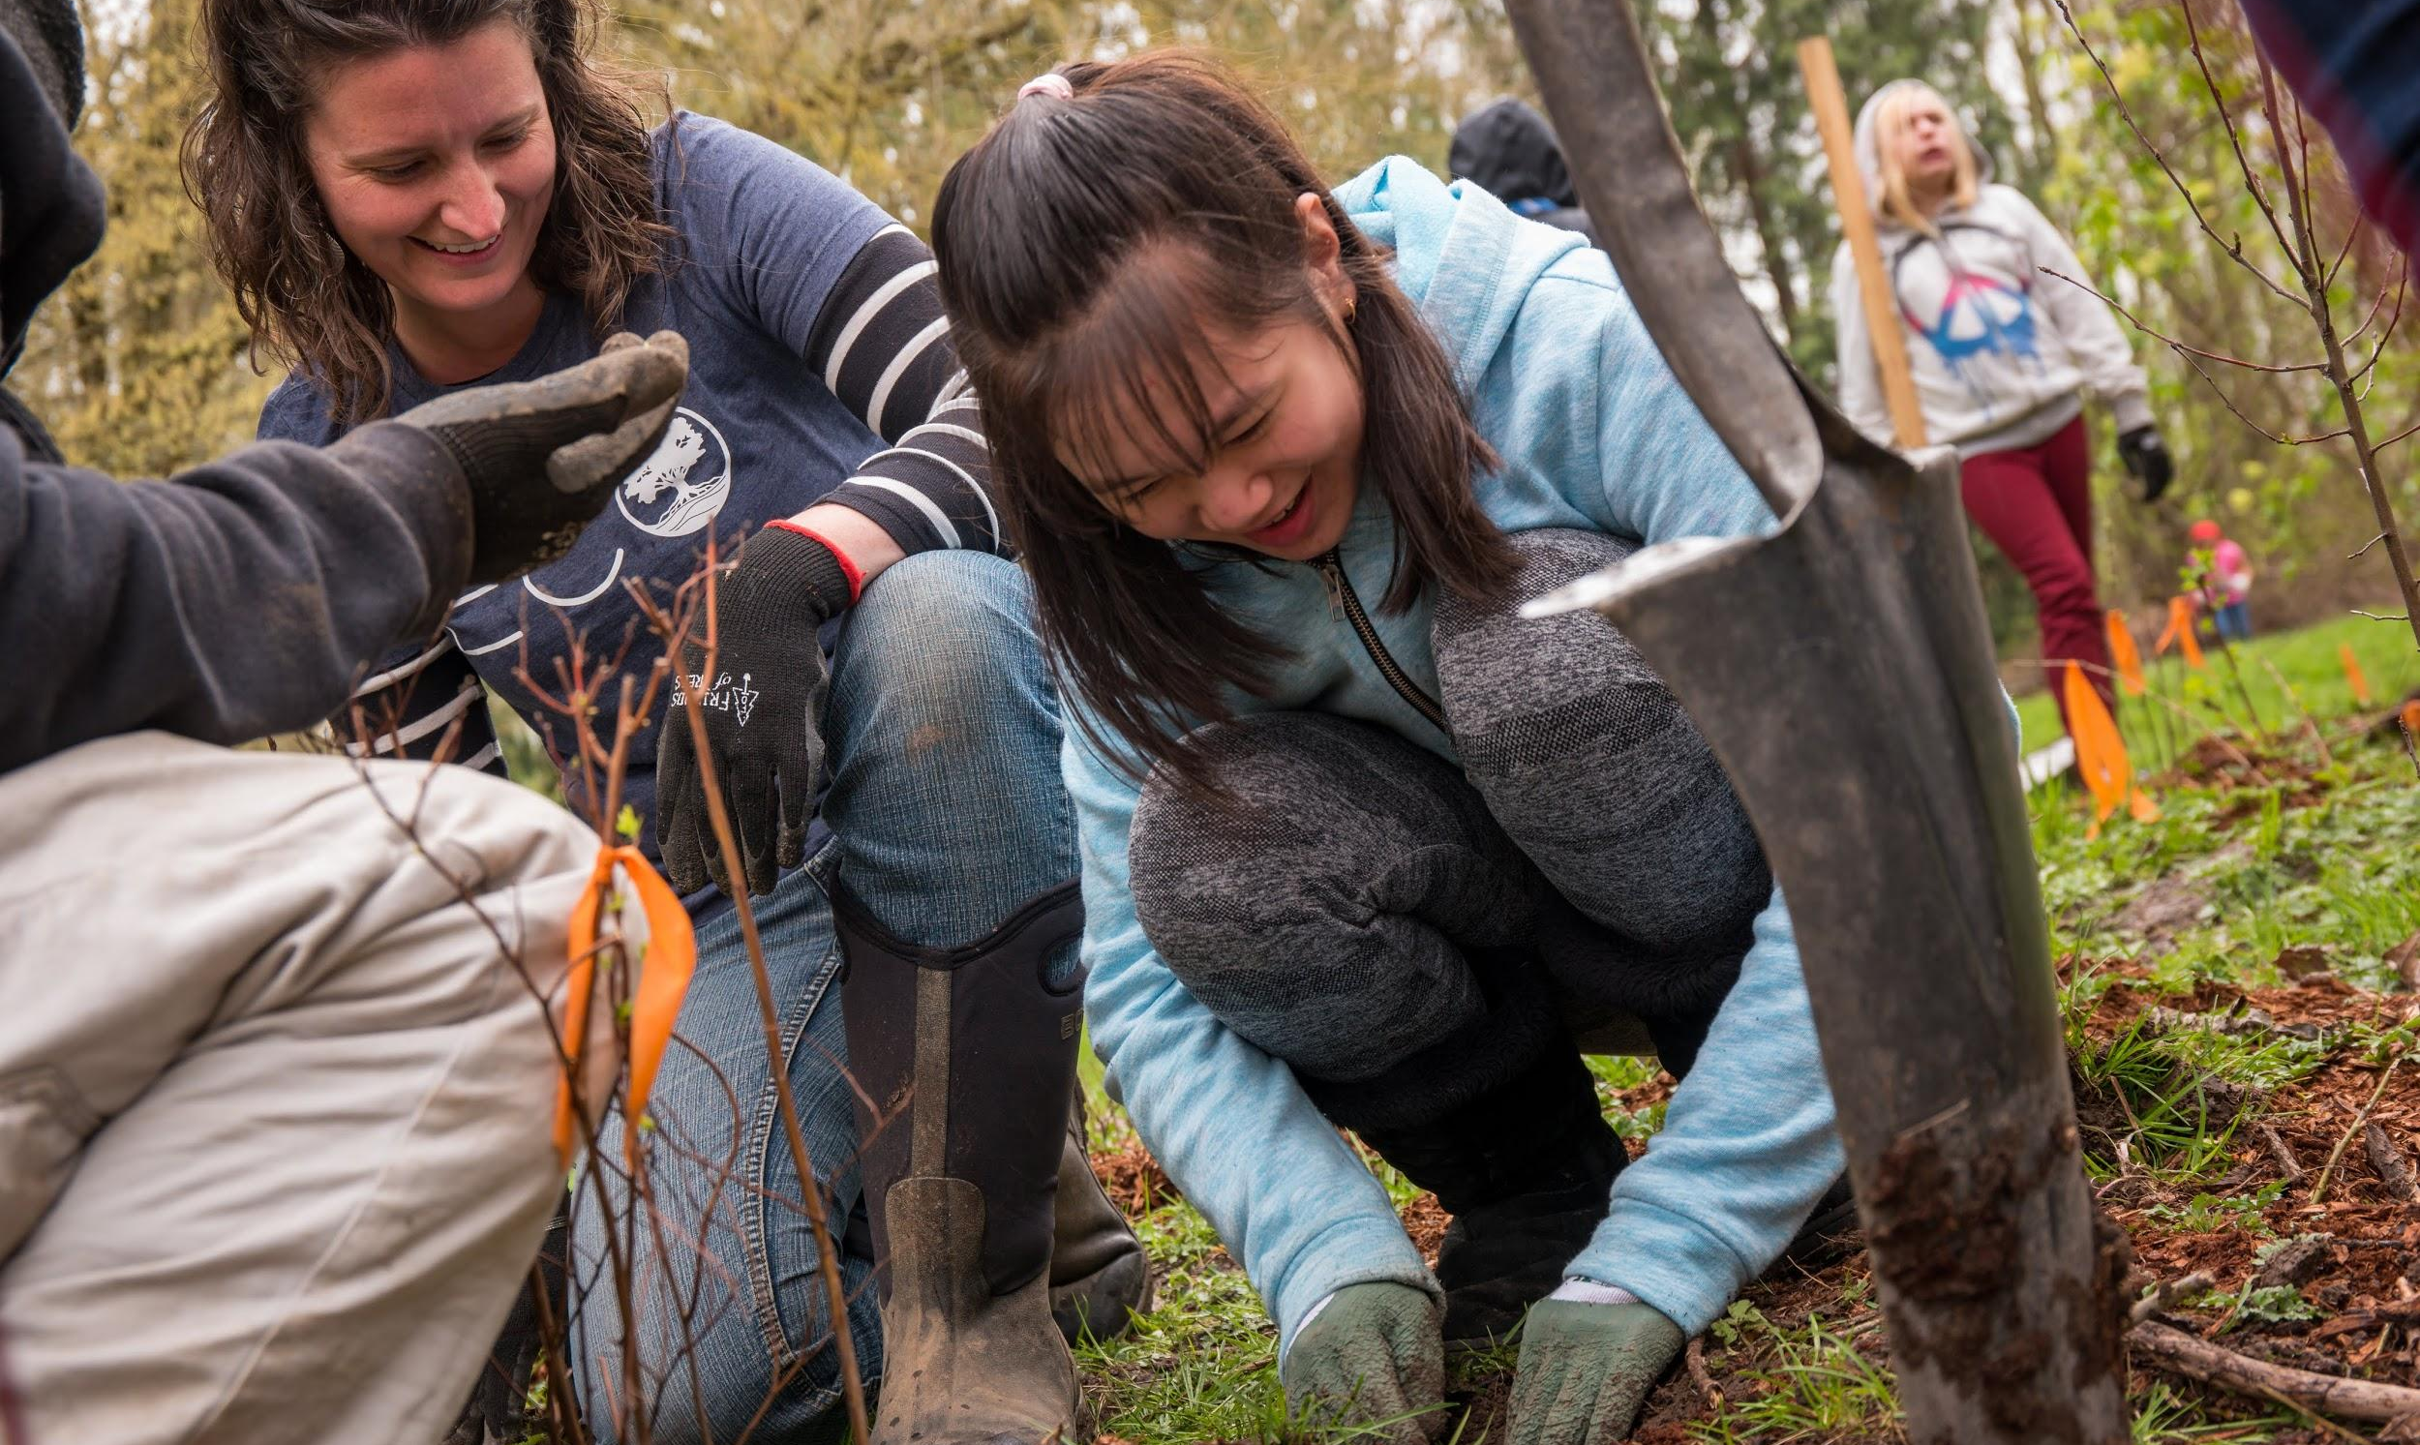
3. Protect fish habitat
Salmon lay their eggs in cold freshwater streams and creeks, where they remain over the winter. Planting native plants along stream banks helps shade the stream and keep the water cool when spring returns.

Slide 12
Activity:
create your own ectotherm!

